Slide 1
Aims of this video
To share with you how phonics is taught in the Reception year at our school.
To suggest ways that you may support your child at home.
To share resources, practical tips and websites.

Slide 2
What is phonics?
Phonics is a method of teaching reading and writing by developing a learners phonetic awareness.
Children learn to hear, identify and manipulate sounds (phonemes) and match these to the letter/s that represent them (graphemes).
Children learn to blend these sounds together to read words and segment words to help spell.

Slide 3
What do some of the terms mean?
Phoneme – The smallest unit of sound in a word, e.g. m,a,s
Grapheme – Graphical representation of a sound/ phoneme – what the sound looks like when written. For some phonemes, this could be more than one letter e.g. t, ai, igh
Digraph – a phoneme represented with 2 letters e.g. ee, ay, ch
Trigraph – a phoneme represented by 3 letters e.g igh, air ure,

Slide 4
What scheme do we use at our school?
We use the Read Write Inc, phonics scheme at Benwick Primary School.
The scheme is broken down into sets.
Set 1 – this is started in Reception and covers all the letters of the alphabet and the consonant diagraph – ch, sh, th, qu ng, and nk.
Set 2 – Once children are confident with Set 1 sounds and can blend and read words using those sounds, children are introduced to set 2 sounds which are vowel sounds made up of diagraphs and triagraphs e.g. ee, oo, igh. Children know these graphemes as ‘special friends’.
Set 3 – This phase covers alternative graphemes e.g. I, igh, y, ie, i-e all have the same sound.

Slide 5
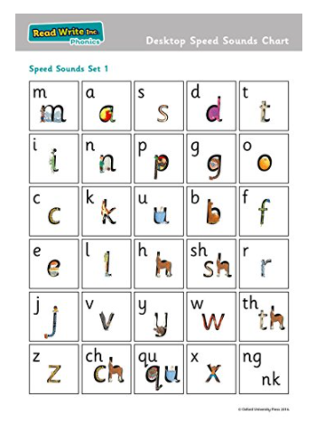
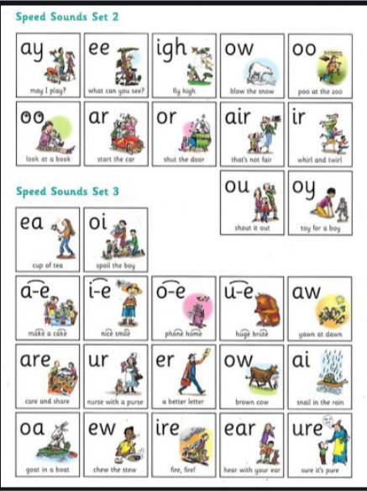

Slide 6
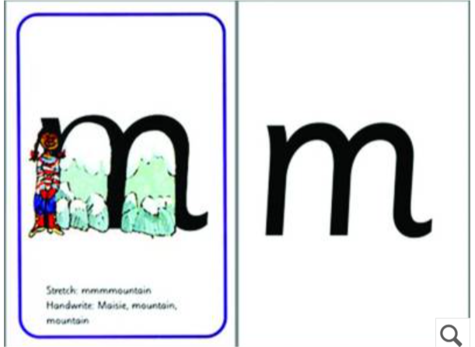
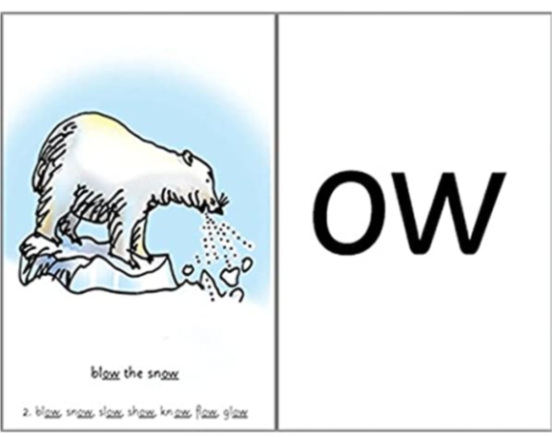
Read Write Inc. Uses flash cards to teach the different sounds to children.
These have a rhyme or mnemonic to help remember them.
M – Maisie Mountain.
ow – blow the snow

Slide 7
Blending and Segmenting
It is important that children know and understand how to blend and segment in order read and spell words correctly.
Blending to read - when phonemes (units of sound) are merged together to pronounce a word. To read an unfamiliar word, a child must link a phoneme to each letter or letter group in a word and then merge them together to say the word = Grapheme-Phoneme Correspondence (GPC) e.g. sh – o – p /– sh ee – p
Segmenting to spell – When individual sounds are heard in a word. To spell a word, a child must segment a word into the individual phonemes and select the relevant grapheme to represent each of these phonemes. We encourage children to say each sound and point to the fingers on their hand as they do so, to enable them to recognise all the sounds in a word.
For example a child may write:
‘The cat was blak. It had a wiet tayl and a pinc noas.’ .

Slide 8
Sound Buttons
can chop
church

Slide 9
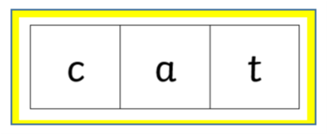
Phoneme Frames

Slide 10
Why is pronunciation important?
Careful pronunciation of sounds is very important to ensure that we are good language models to children.
Sounds should be pronounced softly and in a clipped, short manner. Not with a ‘uhhh’ sound. E.g.
Cuh aaa tuh - C-a-t

Slide 11
What does a daily lesson look like in Reception ?
Revisit – We go through the flashcards of sounds we have already learnt, developing quick recall of the sounds.
Focus sound – Then we look at the focus sound of the lesson. We think of words beginning with that sound. We spot the grapheme amongst the other flashcards.
Handwriting – We then practice our handwriting, forming the lower case letter of the focus sound. We also practice writing the graphemes for 3 or 4 other sounds too.
Fred Talk - Fred is a frog who can only sound out words, he can’t blend and he needs the children to help him blend the words. Fred/adult will sound out words containing the focus sound e.g. the ng sound - s-i-ng, w-i-ng, b-a-ng. Children will then blend these sounds into words.
Speedy Read – We then read a set of words containing the sounds we already know. We begin with sounding these words out and blending, then over the week as we become more confident we begin to sight read these words.
Write – We then make the words using magnets. We ‘Fred Talk’ the word, pointing to the fingers on our hand as we say each sound – this helps us identify all the sounds. We then make the words and write the words.
In Reception we also have activities and games out in our classroom for children to practice their phonics skills independently.

Slide 12
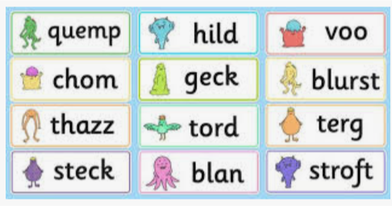
Alien Words and Tricky Words
We practice reading ‘alien’ or ‘nonsense’ words as part of our phonics lesson.
These words give children practise at applying their phonics skills out of context.
There are some words which are not decodable by sounding out. We refer to these as red words or tricky words. We teach these children to sight read these words as a whole word, discussing the part of the word which is ‘tricky’.

Slide 13
High Frequency Words
High frequency words (keywords) are words that we use regularly when we speak, read and write. These words can be sounded out phonetically. There are several ways that we learn these…….
Write the word on paper, cut out each letter and put the word back together.
Write the word three times. Trace over it in different colours.
Look, say, cover, visualise, write, check.
Play bingo with the words.
Write the word in a nonsense sentence.
Find words with similar patterns. e.g. the, them, they
Write the word, draw around the shape of the word and cut out.
Put words into alphabetical order.

Slide 14
Reading
The Read Write Inc. has a levelled reading scheme which complements the phonics programme. Children are given books once they can read the words contained in that book – this promotes a feeling of success for children with their reading as they are able to decode the book straight away. Children will read these books several times in class; repeated reading promotes fluency and greater understanding.
Dittys – When children have learnt Set 1 sounds and are able to blend words; children are given Dittys to read, these are short phrases on a sheet, which tell a simple story.
Red Books – Children progress onto Red Books – these are books which contain 3 Dittys. There are some simple comprehension questions in them too.
Green Books – These are short stories based upon Set 1 sounds. There is also a related book bag book which children take home to practice further.
There are 6 further stages which children will progress to during Reception and KS1 – Purple, Pink, Orange, Yellow, Blue, Grey

Slide 15
Age expectations
All children develop at different age and stages and therefore we ensure that progress is monitored in phonics session regularly. This is rough guide to where children should be each year group.
By the end of reception children to have been taught and know at least one way of representing each phoneme. Children will have learnt to blend sounds together to make words and segment them to help spell.
By the end of year 1 children will have been taught and know alternative graphemes for each phoneme and different pronunciations of the same grapheme and use these to read and spell.
By year 2 children are applying their phonic knowledge and recognising irregularities to spell more complex words and notice spelling patterns.

Slide 16
How you can help at home
Phonics home learning – a sheet has been sent home weekly, showing the sounds we have been focusing on and some words to blend. There are some ideas on the back of the sheet on activities you can do to practice this.
Fred Talk words – in phonics sessions but also for giving instructions – “It’s time for b-e-d. Please pick up your t-oy-s.
You could also play Simon Says game – Simon Says put your hands on your h-ea-d. Encourage your child to take the role of Simon, too.
Reading – Listening to your child read. Aim for 5- 15 minutes a day.
Read to your child so that they can hear a variety of different stories and authors. This helps them develop a rich vocabulary, and an understanding of story language and structure.

Slide 17
How you can help at home
Nursery Rhymes - Practice singing nursery rhymes.
Rhyming games – Play games to help your child identify words that rhyme. One of my favourites is Flamingo Lingo Bingo – stand on one leg, like a flamingo, then say all the words you can think of that rhyme, without falling over!
Games – I-spy, Bingo, snap, pairs games.
Secret Messages – Hide a secret message (could be a letter, a word or a phrase) and encourage your child to find and read it. Can they write a word for you to find?
Word spotting – Spot words in the environment e.g. in a shop window, in a newspaper, on a vehicle.
Please do remember to keep it entertaining
and as practical as possible!
HAVE FUN!

Slide 18
Useful Websites
https://www.ruthmiskin.com/en/programmes/phonics/
https://phonicsfamilycom.wordpress.com/
https://www.bbc.co.uk/bitesize/subjects/zgkw2hv
https://www.topmarks.co.uk/Search.aspx?q=phonics
www.ictgames.com/literacy
http://www.letters-and-sounds.com
www.phonicsplay.co.uk
https://www.phonicsbloom.com/
https://www.teachyourmonstertoread.com/

