Slide 1

Special Educational Needs and Disabilities (SEND)
Benwick Primary School
Information report 2022

Slide 2


Home and school working together
‘Together we can’

Slide 3
The school SENDCo is Mrs Karen Piper
Tel: 01354 677 266
Email: kpiper@benwick.cambs.sch.uk
Benwick Primary School aims to provide high standards of teaching and learning in an environment where each child is valued as an individual and encouraged to achieve their potential. We have high aspirations and expectations for children with SEND. We want to support children to be confident and happy.
At Benwick we believe that all children should have access to a broad, balanced and relevant curriculum which is differentiated to meet the needs of individuals. Extra-curricular activities and after school clubs are accessible for children with SEND. Children with SEND work alongside their classmates as part of everyday school life. We are always happy to meet with parents if they wish to discuss the individual needs of their child. The school will always aim to involve the child in their educational discussions where age appropriate. For example, children having an input into their Annual Review (EHCP students) and the progress towards their outcomes; the provision we would like to make for them in class and discussing personal areas of interest in order to use these as a hook to personalize their learning.

Slide 4

As a school we provide a…
Welcoming, safe, caring, nurturing calm learning environment.
Stimulating learning environment
High quality teaching for all
Creative experiences and opportunities
Restorative practice
STEPs behaviour policy
Support for the whole family
Commitment to teamwork and enriching the lives of
the children

Slide 5

The local offer
The local authority is required to regularly publish and review this information. You can access the local offer at:
www.cambridgeshire.gov.uk
SENDIASS can also support parents of children with SEND further.
The local offer is a opening to information from Education, health and social care about the provision and services that are available for children and young people aged 0-25 who have SEND and their families.

Slide 6

Other support available is…
Medical
Professional service
Community Paediatrician
Speech and language therapy
School nurse
Emotional health and wellbeing service
CAMHS
Occupational therapy
Physiotherapy
Hearing support
Educational Psychologist
Specialist Teaching Team
Statutory Assessment Team
Social care
Sensory Services
Virtual School (CLA)
Counselling
Bereavement

Slide 7
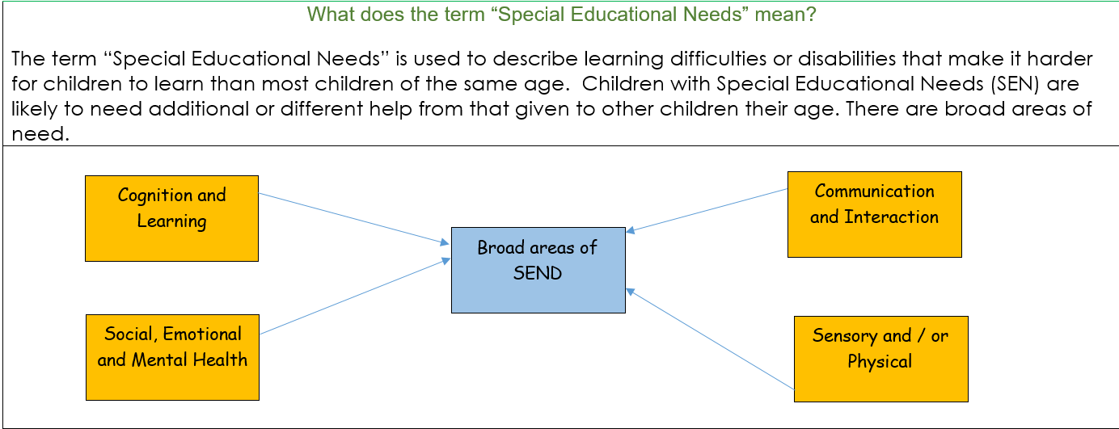

Slide 8
Who should I contact if I think my child has Special Educational Needs?
If you have any concerns about your child’s education you should always speak to your child’s teacher in the first instance. Your child’s teacher knows your child very well and will be able to discuss any concerns with you. They will discuss with you your child’s strengths and difficulties, consider their progress over time and in comparison to their peers. Parents’ consultations and our open door policy mean that a teacher will usually approach you with concerns before you approach them.
However, if this is not the case, you are always welcome to arrange a time to chat with your child’s teacher or to the SENDCo about your child.
Class teacher
SENDCo
Headteacher
Governors

Slide 9
What types of SEN support is available from my child’s school?
High Quality First Teaching – this is the classroom learning which includes well differentiated work to match the needs of all learners including specific strategies as identified by the class teacher or as advised by the SENDCo.
In class support – small group work supported by the teacher or teaching assistant within lessons.
Specialist equipment – sometimes specialist equipment is supplied by school under the direction of the SENDCo. This may include pencil grips, fiddle toys or wobble cushions.
Interventions – these can be in small groups or 1:1 with a child. They usually take place outside of lessons and run by a Teaching Assistant. These groups will be supervised by the Class Teacher.
Specialist work – undertaken by outside professionals such as Speech and Language Therapists (SALT), specialist teaching team practitioners or physiotherapy.

Slide 10
How will the school know if my child has Special Educational Needs?
To ensure that all children in our school reach their full potential, we are continually assessing children and planning to meet individual needs through a continuous cycle of planning, assessment and monitoring. There are half termly meetings with the Head Teacher to discuss pupil progress and identify children who may need additional support. We will be looking for children who:
are making slower progress than other children who started at the same level
have changed their rate of progress
have an underlying medical condition
are finding particular aspects of the curriculum difficult
High quality teaching needs to be provided to ensure that we address individual needs. For some children, targeting their areas of difficulty will see their learning improve. If your child continues to make slow progress, we will need to gather further information through observations, work and conversations to obtain an overall view of your child and their overall functioning and needs. We will then invite you to a meeting with the SENDCO and class teacher. Before the meeting, we will listen to your child’s views to ensure that they are involved with the process. At the meeting we may decide that your child has special educational needs and at that point with your agreement your child will be put on the Special Educational Needs register at SEN Support.

Slide 11
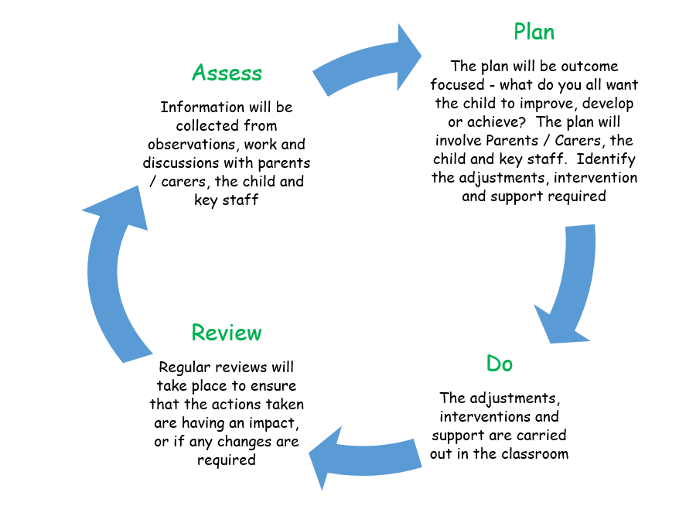
What kinds of Special Educational Needs can the school help my child with?
Benwick Primary School is a fully inclusive school, where each child is treated as an individual. We strive to ensure that all children are able to achieve their full potential. We aim to identify individual needs and support these to ensure that all children make progress.
All children on the special needs register will have an individual plan written by the class overseen by the SENDCo. This diagram shows how there is a continuous and cyclical assessment process being undertaken throughout the school year. These plans are reviewed and changed termly. The plan will be discussed and amended with parents by the class teacher. For some children it may be necessary to arrange for specialist assessments and support from an outside agency. However, before we contact any agencies it would be discussed with parents first.

Slide 12

How will the child themselves be involved with discussions?
Children with SEN often have knowledge about their own needs along with the sort of support and help that they may need in order to be able to fulfil their full potential. Children will be encouraged to provide their views about their learning and the next steps that need to be taken, along with the type of support that they find useful. As a school we will always work in the best interests of the child, particularly if the child is not so aware of their own specific needs.

Slide 13
How will the school measure the progress of my child?
Your child’s progress is continually monitored by the class teacher and discussed termly at Pupil Progress Meetings.
Each child from Reception to Year 6 is assessed termly against the end of year expectations which are part of the National Curriculum.
At the end of each Key Stage (Years 2 & 6) all children are formally assessed using the Standard Assessment Tests (SATs) along with Teacher Assessment. This is a statutory requirement.
Children with an EHC Plan are also formally reviewed at an Annual Review Meeting with parents, staff and other professionals involved in your child’s care and education.
Pupil work study or ‘book looks’, planning scrutiny and lesson visits will be undertaken regularly by the Senior Leadership Team to ensure that the needs of all learners are met and that teaching is of a high standard.

Slide 14
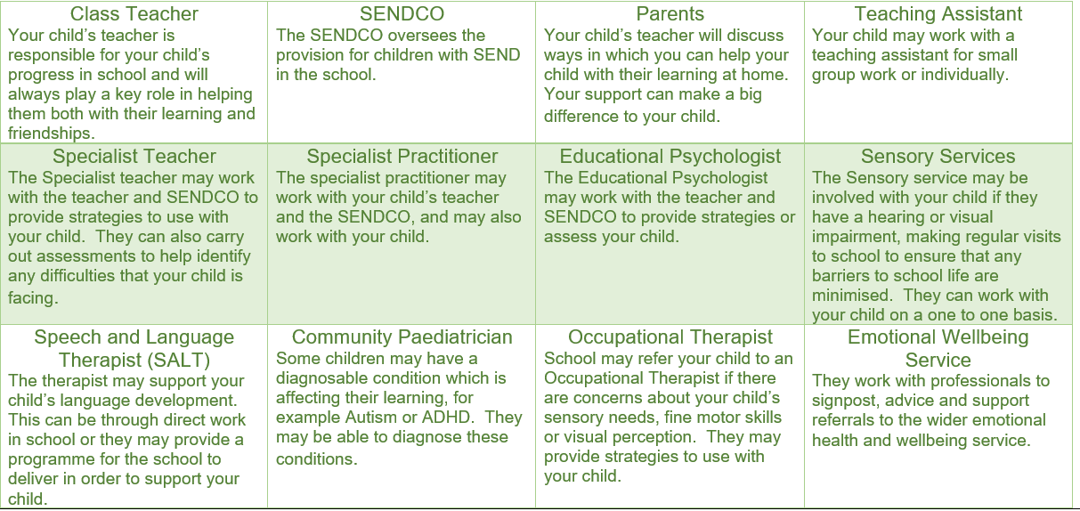
Who will be involved in helping my child?
It depends upon the needs of the child as to how many people will be involved with your child. For some children it may be just the class teacher, the SENDCO and parents. However, for others this may extend to other outside professionals. There are some of the people who may be involved with your child:

Slide 15

What support is available for ensuring the emotional and social development of children with SEND?
All of our children are aware that they can talk to any adult within the school concerning any aspect of school life. Our school has adopted the STEP’s approach to behaviour and restorative approaches to ensure that all views are listened to as well as respected. Children are supported through the lunchtime activities, social skills groups, circle time, PSHCE lessons, emotional literacy sessions and by the use of social stories. We can also ask advice from outside agencies if appropriate.
Benwick provides the children with clear rules, boundaries and clear structure throughout the school, along with rewards which are celebrated in our Friday celebratory assembly. Visual timetables are displayed so that children know what to expect throughout the day.

Slide 16

What happens when my child moves between classes or moves schools?
We recognise that transitions can be difficult for children particularly for those with SEND and take early steps to ensure that any transition is as smooth as possible.
As your child progresses through school, they will continue to receive SEN support.
The teachers will make sure that SEN records are passed from class to class and hold transition meetings to discuss children’s needs.
All children will have the opportunity to visit their new classroom and to meet the new staff that will be working with them. When moving to secondary school additional transition meetings and visits may take place.
The amount of time needed for the visits and familiarisation with staff will be tailored to the individual child’s needs.
If your child is leaving the school, then we will ensure that all your child’s records are transferred to their new school.
If your child joins us part way through their school journey, we would encourage visits to the school prior to starting. We will contact the previous school to ensure that the key information is passed on and that we are fully informed about your child. Any information received from the previous school will be used by the teacher to identify how to support your child in school and help plan the next steps of your child’s journey.

Slide 17
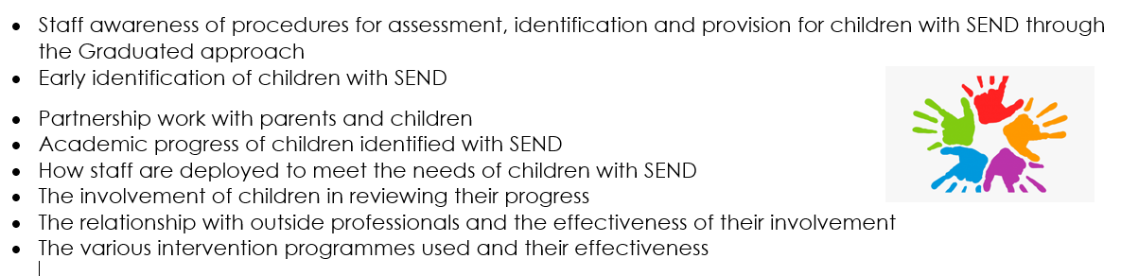
How does the school evaluate how effective the support is for children with SEND?
The support for children will be reviewed continuously to ensure that we as a school are meeting the needs of the children. A number of areas are considered including:
The school produces a Provision map showing any additional support children are receiving, along with the frequency of support and detailing the impact of this. The SENDCO provides a SEND report to the governing body and regularly meets with the SEND governor.

Slide 18

Where can I get extra support and advice?
There are many organisations that will provide support for families with children who have Special educational needs and or disability.
Understanding SEND
SEND Code of Practice 0 to 25
https://www.gov.uk/government/publications/send-code-of-practice-0-to-25
Cambridgeshire County Council’s Local offer which details services available in the Cambridgeshire Area
https://www.cambridgeshire.gov.uk/residents/children-and-families/local-offer/about-cambridgeshire-s-local-offer
Pinpoint
A registered Cambridgeshire charity that provides help and support for parents with children who have special needs. It is run by parents for parents and gives guidance on services children are entitled to and how to access them.
https://www.pinpoint-cambs.org.uk/
SENDIASS – SEND Information, Advice and Support Service
Offer impartial and confidential information, advice and support to parents who have a child or young person with Special educational needs or a disability.
https://www.cambridgeshire.gov.uk/residents/children-and-families/local-offer/local-offer-care-and-family-support/send-information-advice-and-support-service-sendiass

Slide 19

Early Intervention Family Worker
Our Family Support Worker offers help with challenging behaviour, establishing routines, raising self-esteem, increasing confidence and improving family relationships. Look out for the regular newsletters in your email box.
Cambridgeshire Early Help Assessment
Sometimes it is difficult to know exactly what help you and your child need. In these cases, the Cambridgeshire Early Help Assessment is an ideal tool to help. It is a way of identifying whether a child needs extra support and working out the best way to provide that support. https://www.cambridgeshire.gov.uk/residents/children-and-families/parenting-and-family-support/providing-children-and-family-services-how-we-work/early-help-assessments

Slide 20
What happens if I’m not happy with the support my child is receiving?
At Benwick Primary School, we aim to work in partnership with parents/carers to ensure that a joint approach is in place to meet your child’s needs. Any complaints regarding SEND provision should initially be discussed with the child’s class teacher, SENDCO or raised with the Head Teacher. If a satisfactory outcome cannot be agreed, you should follow the steps outlined in the School’s Complaint Procedures Policy document, which is available in the school office and on the website.

